Slide 1
“ Welcome To”
SMART INDIAN SHOP
www.smartindianshop.com
A LIFE CHANGING BUSINESS OPPORTUNITY
Contact~ +91-7044191339

Slide 2
3 Night / 4 Days Holiday Voucher
Deluxe category hotels with star facilities where ever possible at desired
destination for three night and four days on twin sharing basis, for 2 Adults
& 2 Children below the age of 5 yrs.
60 Hotels/Resorts to choose from 15 international & 45 options in India.
Meal credit of Rs 2000/- to be consumed at the hotel of stay according to
menu card rates.
Valid for 12 months from the date of issue.

Slide 3
3 Night / 4 Days Flight Voucher
Deluxe category hotels with star facilities where ever possible at desired
destination for three night and four days accommodation for one adult.
60 Hotels/Resorts to choose from 15 international & 45 options in India.
Meal credit of Rs 2000/- to be consumed at the hotel of stay according to
menu card rates.
Up & Down Air Ticket also provide by us.
Valid for 12 months from the date of issue.

Slide 4
List of Hotels – Asia
S.No. | Destination | Country | Hotel/Resort
1 | Bangkok | Thailand | Baiyoke Suite Hotel
2 | Bangkok | Thailand | Howard Square
3 | Pattaya | Thailand | Four Season Places
4 | Pattaya | Thailand | Beverly Plaza
5 | Kuala Lumpur | Malaysia | Grand Continental
6 | Chiang Mai | Thailand | Residency
9 | Chitwan | Thailand | Safari Adventure
10 | Genting | Malaysia | First World
11 | Karabi | Thailand | The Pine Bunglows
12 | Kathmandu | Nepal | Hotel Prince
13 | Phuket | Thailand | Karon On The Hill
14 | Phi Phi | Thailand | Andaman Beach Resort
15 | Pokhra | Nepal | Kantipur

Slide 5
List of Hotels – India
S.No. | Destination | State | Hotel/Resort
26 | Goa | Goa | Hotel Sea Horse Resort
27 | Chamba | Himachal Pradesh | Aroma Palace
28 | Dharamshala | Himachal Pradesh | Imperial Heights
29 | Khajjiar | Himachal Pradesh | Royal Residency
30 | Mount Abu | Rajasthan | H G Grandiose
31 | Mukteshwar | Uttarakhand | Lord Cottages & Villas
32 | Shirdi | Maharashtra | Reeva Regency
33 | Naldhera | Himachal Pradesh | Golf Link Resort
34 | Agra | Uttar Pradesh | Hotel Taj Inn
35 | Digha | West Bengal | Hotel Dolphin

Slide 6
List of Hotels - India
S.No. | Destination | State | Hotel/Resort
36 | Ooty | Tamil Nadu | Heaven Holidays
37 | Palampur | Himachal Pradesh | Saklani Cottage
38 | Ranikhet | Uttarakhand | Parvati Inn
39 | Kodaikanal | Tamil Nadu | Silver Castel
40 | Munnar | Kerala | Hotel Munnar Castel
41 | Tirupati | Andhra Pradesh | Udayee International
42 | Kanyakumari | Tamilnadu | Seeba Palace
43 | Mahabalipuram | Tamilnadu | Shore Line
44 | Matheran | Maharastra | Horseland Resort
45 | Darjeeling | West Bengal | North Star

Slide 7
List of Hotels – India
S.No. | Destination | State | Hotel/Resort
46 | Srinagar | Jammu & Kashmir | Hotel Paradise
47 | Puri | Orissa | Surya Beach Inn
48 | Patnitop | Jammu & Kashmir | Vardaan Resorts
49 | Jaipur | Rajasthan | Royal Pallazo
50 | Bikaner | Rajasthan | Sagar Hotel
51 | Jaisalmer | Rajasthan | Mahadev Palace
52 | Jodhpur | Rajasthan | Chandra Inn
53 | Udaipur | Rajasthan | Quality Inn Vishnupriya
54 | Pushkar | Rajasthan | Gulam Niwaz Palace
55 | Ranthambore | Rajasthan | The Pugmarks

Slide 8
TERMS AND CONDITIONS
3-4 Star category Hotels /Resorts
60 Hotels / Resorts to choose from 15 International &
45 options in India
Valid for a Couple & Two Children below 5 years
Customer can plan the holidays every easily (Valid for 10 to 12 months)
Customer pays Rs. 499-/ / 649-/ as a Utility Charges per voucher after getting
the confirmation for available destination
No compulsion of Food & Beverages in the Hotels /Resorts10% to 20%
Discount on Food & Beverages if consumed.
Service Tax 14% Extra with every Package.

Slide 9
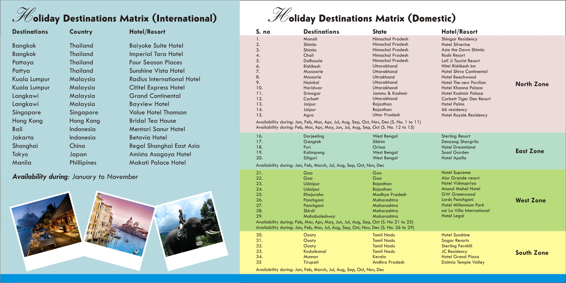

Slide 10
Rewards with This Package
Joining With Rs.3000/- Get 5 Stem Cell Drop Or Upcoming Tour Package
10 ID – TITAN WRIST WATCH (20 Days)
25 ID – TAB (45 Days)
50 ID – SMART PHONE (75 Days)

Slide 11
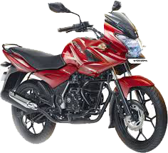
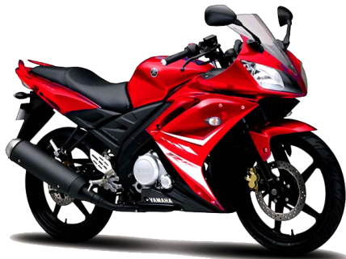
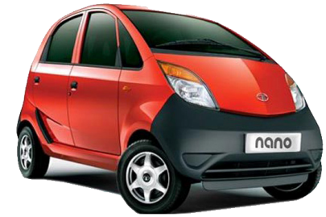
75 ID – LAPTOP (100 Days)
150 ID – Two Wheeler (150 Days)
Or
300 ID – NANO or Two Wheeler
(240 Days)
550 ID – Alto 800 Car (420 Days)

Slide 12
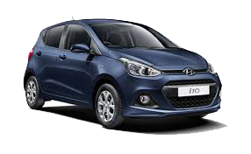
1100 ID – Hyundai I-10 Car (570 Days)
2500 ID – Mahindra Scorpio Car
(720 Days)
4000 ID – 2 BHK Flat Value with 15Lakh (840 Days)

Slide 13
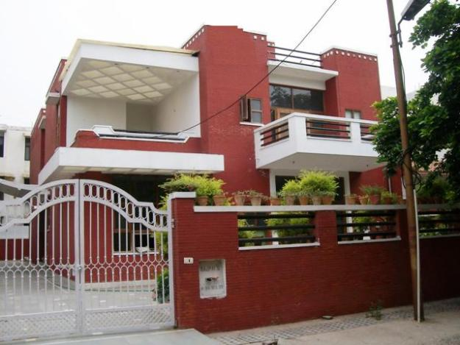
6000 ID – 3 BHK Flat Value
with 25Lakh (960 Days)
10000 ID – BMW CAR
Value 35 Lakh (1100 Days)
25000 ID – Bunglow Value with
75Lakh (1250 Days)

Slide 14
50000 ID – Bunglow + Audi A6 Car (1400 Days)
+

Slide 15
Terms & Conditions :-
1) All Rewards as per Team RATIO 40:60 ,
2) ONE ID CAN TAKE ONE REWARDS.
3) NEXT TO NEXT CALCULATION .
4) On Tour Package 14% S.C. will be extra.
5) On Stem Cell Drop No extra charge apply.
6) All Two Wheeler & Car Payment as per Ex- Showroom Rate.
7) With Effect From 15/12/2015,
8) All Rewards given on Company Seminar.

Slide 17
Special Announcement :-
1) Rice Bran Oil within January ,
2) Flight Tour Voucher .
3) Recharge Facility from e-wallet and many more .
4) AGRO Product Coming soon
5) Many BEAUTY Care Product Launch within February.
6) Group CUG Facility Coming Soon.
7) Repurchase bonus slab change coming Jan-16
8)OFFER:-
Travel & Fuel Fund ACHIEVE Within 28 th Feb16
Or
Bike Achievement from new Rewards opportunity (3000 Pack)
Company Will Arrange a Tour for 2 Night in a Tourist Spot with Achievers,

