Slide 1
WEL COME
TO
SMART INDIAN SHOP
II श्री गणेशाय नमः II

Slide 2
LIFE CHANGING
BUSINESS
OPPORTUNITY

Slide 3
Question is…
Why a person need an Opportunity…?
Statics is Showing the Answer,
Are you agree?
Rs: 100000/-
Let’s See The Monthly Cost of Living for a common Man in India in last few decades.
Rs: 10000/-
Sources:
Planning Commission
Govt. of India
Rs: 1000/-
Rs: 100/-
Rs: 10/-
Rs: 1/-
1920 1940 1960 1980 2000 2020

Slide 4
Price Inflation in last few decades
Products | 1980 | 1990 | 2000 | 2010 | 2020*
Tooth Paste | 7.25 | 14.25 | 29.50 | 55.00 | 95.00
Bath Soap | 2.25 | 5.75 | 11.00 | 24.00 | 45.00
Salt per Kg | 1.00 | 2.90 | 6.50 | 12.00 | 19.00
Sugar per Kg | 3.50 | 7.25 | 14.75 | 35.00 | 51.00
Milk per ltr | 3.00 | 6.00 | 13.00 | 25.00 | 36.00
Rice per kg | 2.00 | 4.50 | 11.00 | 32.00 | 45.00
Masala Dosa | 3.50 | 10.00 | 18.00 | 35.00 | 55.00
Petrol Per Ltr | 6.80 | 12.23 | 28.70 | 51.43 | 100.00
LPG Gas | 45.15 | 67.90 | 232.25 | 345.35 | 575.00
Branded Shirts | 95.00 | 250.00 | 600.00 | 1600.00 | 2400.00
10 gms Gold | 1330.00 | 3200.00 | 4400.00 | 18500.00 | 40000.00
*Assumption
We Must need an Opportunity...

Slide 5
Hello!!! Are you busy running everyday
trying to fulfill your ‘BIG’ dreams?

Slide 6
So, what are your
DREAMS?

Slide 7
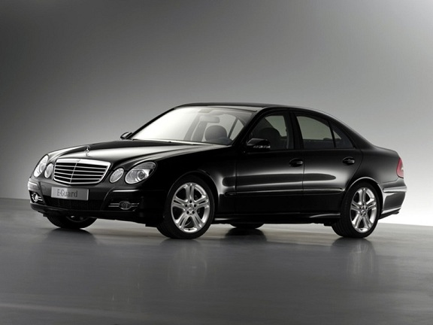
Do You Wish to have a Luxury Car…?
(Explore The Luxury)

Slide 8
Do You Love Holidaying…?
(Explore Diverse Heritage ~ Culture ~ Language ~ Food ~ Dress ~ Beaches ~ Mountains ~ Wild Life)

Slide 9
Do You wish to have a Big Villa…?
(Explore the Luxury Stay at home)

Slide 10
Do You Wish to Have Time Freedom?
(Spend Quality time with Your Family and go on Frequent Vacation to Your Favorite Holiday Destinations)
Freedom

Slide 11
Do You Wish to Have Money Freedom?
(Look beyond Just Survival & Have enough Financial Resources to Live a Quality Life without Stress)

Slide 12
Do You Wish To Send Your Child to Top Institute?
(Child’s Education)

Slide 13
Do You Wish to have Best Plan for Child’s Marriage?
(Child’s Marriage)

Slide 14
Total Cost Rs. 100,00,000 ?
If You Save 50,000 Per Month…
Rs. 50,000 X 12 Month = 6,00,000
Rs. 6,00,000 X 10 Years = 60,00,000
Do You Earn
Rs. 50,000 Per Month ?
What About Your Dreams ?

Slide 15
Dreams ???

Slide 16
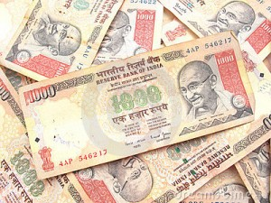
“Mana ke Paisa Khuda nahi,Lekin Dosto yeh Khuda se kam bhi nahi………….!!”
Have You Big Bank Balance?

Slide 17
But, what is your
Plan??

Slide 18
Then what to do?
There are 4 ways to earn Money
E = EMPLOYEE
You have a
Job
B = BUSINESS
You own a system & People work for you
Want to Switch?
What is Common in both
What is Common in both
Individual effort
Active Income
Limited Earning
Team work
Passive Income
Unlimited Earning
S = SELF EMPLOYED
Your own
Job
I = INVESTMENT
Money works for
You
Become a Business Owner where People work for you.

Slide 19
Well, now that you are here, may be you need some help!!
Let me share with you Our Speed Plan
to help you Achieve Your Dreams!!

Slide 20
“ Welcome To”
SMART INDIAN SHOP
www.smartindianshop.com
A LIFE CHANGING BUSINESS OPPORTUNITY
Contact~ +91-7044191339

Slide 21
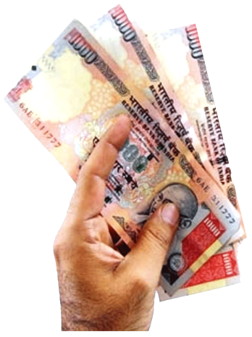
SMART INDIAN SHOP
www.smartindianshop.com
Presents A Life Changing Business Opportunity
The Right Company The Right Product
*** The Right Compensation
***The Right Leadership
***The Right Timing

Slide 22
SMART INDIAN SHOP
www.smartindianshop.com
About Us:-
"To make people Healthy To make people Wealthy"
To provide natural, high quality, daily consumable, rejuvenating health product at reasonable prices. Product which everyone wants, everyone needs and everyone loves.
To provide a simple & best business plan. To provide an outstanding opportunity for those who want to build a better lifestyle for themselves and their families.
To provide equal opportunity to all sections of the society. To become the biggest direct selling organization in India and changing the lives of those who believe in it.

Slide 23
SMART INDIAN SHOP
www.smartindianshop.com
Powerful Management Team of Smart Indian Shop
CMD
Director
Director
Company Development Committee
Leaders & Distributors

Slide 24
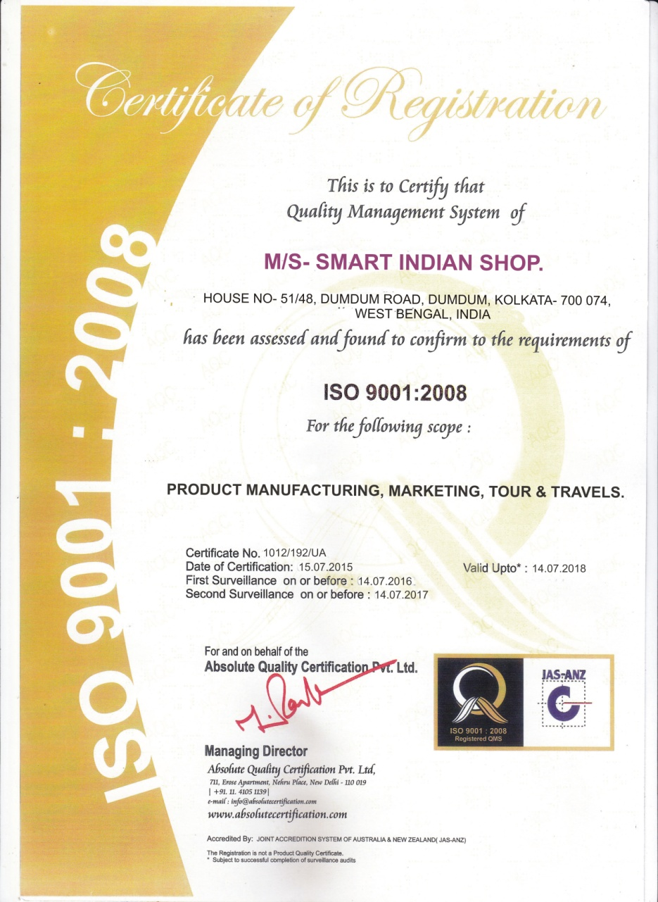
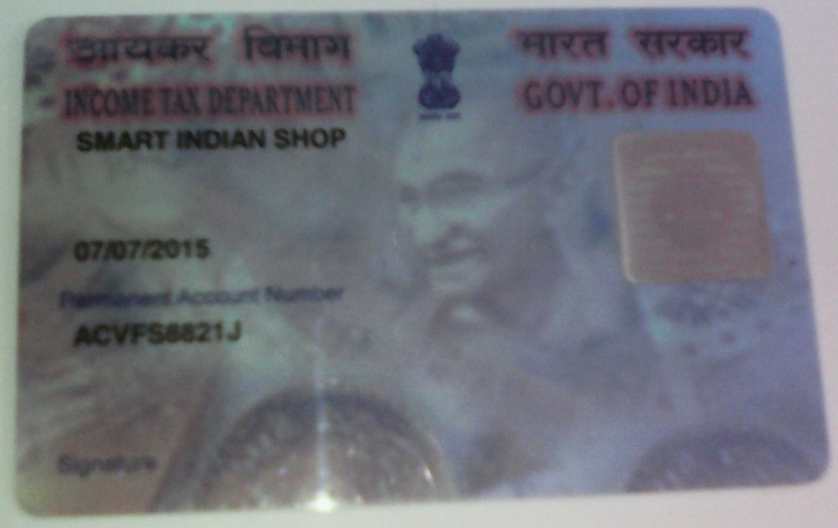
Certificates:-
SMART INDIAN SHOP

Slide 26
There are
SMART INDIAN SHOP
Many ways to make
Money
with
www.smartindianshop.com

Slide 27
Forteen types of Income:-
SMART INDIAN SHOP
1. Level Bonus.
2.Auto Pull Bonus.
3.Royalty Club Bonus.
4.CNF Bonus.
5.Franchise Bonus.
6.Introduce Franchise Bonus.
7.Awards & Rewards.
8.Re- Purchase Bonus.
9 to14. And 6 Type of Funds Bonus.

Slide 29
SMART INDIAN SHOP
2. Auto Pull Bonus:-
LEVEL | Members | Bonus Rate | Total Earn
Level- 1 | 3 | 150 | 450
Level- 2 | 9 | 70 | 630
Level- 3 | 27 | 50 | 1350
Level- 4 | 81 | 40 | 3240
Level- 5 | 243 | 30 | 7290
Level- 6 | 729 | 20 | 14580
Level- 7 | 2187 | 20 | 43740
Level- 8 | 6561 | 15 | 98415
Level- 9 | 19683 | 15 | 295245
Level- 10 | 59049 | 20 | 1180980
Level- 11 | 177147 | 20 | 3542940
TOTAL | 2,65,719 | 450 | Rs. 51,88,860
*** For Running “Auto Pull” System, another 2 Entry System for “Auto Pull”:-
i) Re- Purchase ( Every 10000 “BV” sale from Company 1 free Id goes to Auto Pull).
ii) When any Distributor ID get “Royalty + Auto Pull” income Rs.5000/-, Then Rs.500/-deducted
from that wallet & send 1 ID to Auto Pull.

Slide 30
SMART INDIAN SHOP
3. Royalty Club Achiever Bonus:-
Cutting Rs.20/- from Total Monthly
Joining ID of Company, and Cutting 3%
From Total Re-Purchase “BV” in a
Month of Company, And then It’s Equal
Divided to Achievers of Royalty Club.
*** Royalty Achieving System:-
When Any ID Qualify For Auto Pull & Create 500 ID (Ratio-40:60) on His / Her Team in any Duration (No Time Limit).
When Any ID Qualify For Auto Pull & Create 100 ID (Ratio-40:60) on His / Her Team within 60 days From Join.
*** 40:60 Ratio (One Leg Strong, 40% ID from it and Next all Leg accumulated 60% ID).

Slide 31
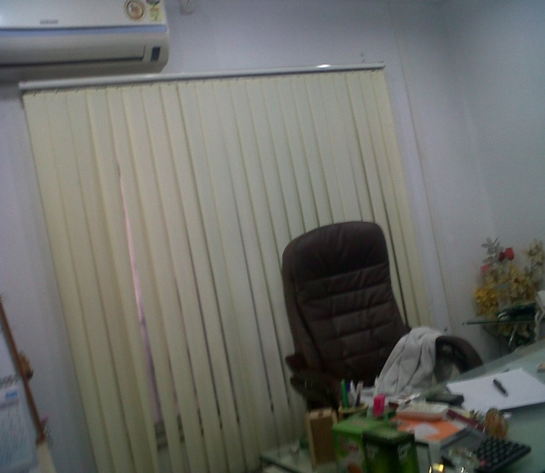
SMART INDIAN SHOP
www.smartindianshop.com
4. CNF Holder Bonus:-
If any Member Purchase 100 Joining Kit at a time
then He / She Eligible for CNF holder of an Area ,
and get Rs.60/- from Joining Pack Lifetime, And
also earn 12% of Re-Purchase “BV” from his
“CNF” Point. (If any Franchise holder of Company
Under this CNF then all benefit of Franchise holder
will deduct from “CNF” Bonus Percentage).

Slide 32
SMART INDIAN SHOP
www.smartindianshop.com
5. Franchise Holder Bonus:-
If any Member Purchase 25 Joining Kit at a time
then He / She Eligible for Franchise holder and
get Rs.40/- from Joining Pack Lifetime.
And also earn 7% of Re-Purchase “BV” from
his/her Franchise Point.

Slide 33
SMART INDIAN SHOP
www.smartindianshop.com
6. Franchise Introducer Bonus:-
If any Member Introduce Franchise then He / She
get Rs.10/- From Joining Kit Lifetime. And also
earn 1% of Re-Purchase “BV” from his Introduce
Franchise Point as Monthly basis.

Slide 36
SMART INDIAN SHOP
STAR Distributor
9. Meeting & Seminar Fund Bonus:-
Company will Cutting 2% From Total Re-Purchase
“BV” in a Month of Company, Then Its Equal Divided
to Achievers of “Meeting & Seminar Fund Bonus”.
***If any Member or Distributor Sale 45,000 “BV” (Ratio-40:60)from His / Her
Team in a Month, or Sale 1,00,000 “BV” (Ratio-40:60)Accumulated from team
(No time limit) & Continue Sale 15,000 “BV” Per Month From Team for Next
Two Month, then He / She can eligible for “Meeting & Seminar Fund Bonus”.

Slide 37
SMART INDIAN SHOP
Silver STAR Distributor
10. Travel & Fuel Fund Bonus:-
Company will Cutting 2% From Total Re-Purchase
“BV” in a Month of Company, Then Its Equal Divided
to Achievers of “Travel & Fuel Fund Bonus”.
***If any Member or Distributor Sale 60,000 “BV” (Ratio-40:60)from His / Her
Team in a Month, or Sale 1,50,000 “BV” (Ratio-40:60)Accumulated from
team(No time limit) & Continue Sale 25,000 “BV” Per Month From Team for
Next Two Month, then He / She can eligible for “Travel & Fuel Fund Bonus”.

Slide 38
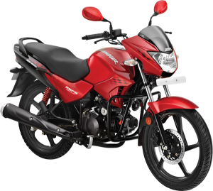
SMART INDIAN SHOP
Gold STAR Distributor
11. Bike Fund Bonus:-
Company will Cutting 2% From Total Re-Purchase
“BV” in a Month of Company, Then Its Equal Divided
to Achievers of “BIKE Fund Bonus”.
***If any Member or Distributor Sale 3,00,000 (Three Lakh) “BV” (Ratio-40:60)
Accumulated from team (No time limit) & Continue Sale 25,000 “BV” Per Month
From Team for Next Two Month, then He / She can eligible for “BIKE Fund Bonus”.

Slide 39
SMART INDIAN SHOP
Platinum STAR Distributor
12. Car Fund Bonus:-
Company will Cutting 2% From Total Re-Purchase
“BV” in a Month of Company, Then Its Equal Divided to
Achievers of “CAR Fund Bonus”.
***If any Member or Distributor Sale 6,00,000 (Six Lakh) “BV” (Ratio-40:60)
Accumulated from team (No time limit) & Continue Sale 25,000 “BV” Per Month
From Team for Next Two Month, then He / She can eligible for “CAR Fund Bonus”.

Slide 40
SMART INDIAN SHOP
Diamond STAR Distributor
13. Medical & Health Fund Bonus:-
Company will Cutting 2% From Total Re-Purchase
“BV” in a Month of Company, Then Its Equal Divided to
Achievers of “Medical & Health Fund Bonus”.
***If any Member or Distributor Sale 9,00,000 (Nine Lakh) “BV” (Ratio-40:60)
Accumulated from team (No time limit) & Continue Sale 25,000 “BV” Per Month
From Team for Next Two Month, then He / She can eligible for “Medical &
Health Fund Bonus”.

Slide 41
SMART INDIAN SHOP
Black Diamond STAR
14. House Fund Bonus:-
Company will Cutting 2% From Total Re-Purchase
“BV” in a Month of Company, Then Its Equal Divided
to Achievers of “HOUSE Fund Bonus”.
***If any Member or Distributor Sale 12,00,000 (Twelve Lakh) “BV”
(Ratio-40:60) Accumulated from team (No time limit) & Continue Sale 25,000
“BV” Per Month From Team for Next Two Month, then He / She can eligible
for “HOUSE Fund Bonus”.

Slide 42
Happy Life
Contact~ +91-7044191339

Slide 43
BENEFIT OF NOMINATION:-
The www.smartindianshop.com Business Income is
not only for you, but also for
YOUR GENERATIONS TO COME!
What we believe:
If you are doing the same thing what you are doing all these years, you will get the same thing what you getting till date.
In order to get something more, you need to do something different…
!

Slide 44
SMART INDIAN SHOP
Opportunity is never lost
Your world will turn Today
www.smartindianshop.com
Contact~ +91-7044191339

